Slide 1
04 End-to-End Protocols-2

Slide 2
Outline
Reliable data transfer (Chapter 2)
Congestion Control (Chapter 7)

Slide 3
Reliable Data Transfer
Error types
Error detection
Eg.
Feedback
Types
Other info
Loss detection
Retransmission
When
What
Automatic Repeat reQuest (ARQ) protocol

Slide 4
Stop-and-Wait Protocol
Error detection
Feedback
Retransmission
Sender buffer
Receiver buffer
Sequence number
Timer

Slide 5

Stop-and-Wait in action
sender
receiver
sender
receiver
send pkt0
pkt0
send pkt0
pkt0
rcv pkt0
rcv pkt0
ack0
send ack0
ack0
send ack0
rcv ack0
rcv ack0
send pkt1
pkt1
send pkt1
pkt1
rcv pkt1
X
ack1
send ack1
loss
rcv ack1
send pkt0
pkt0
rcv pkt0
timeout
resend pkt1
ack0
send ack0
pkt1
rcv pkt1
ack1
send ack1
rcv ack1
send pkt0
pkt0
(a) no loss
rcv pkt0
ack0
send ack0
(b) packet loss

Slide 6
Stop-and-Wait in action
sender
receiver
sender
receiver
send pkt0
pkt0
send pkt0
pkt0
rcv pkt0
rcv pkt0
ack0
send ack0
send ack0
rcv ack0
ack0
send pkt1
pkt1
rcv ack0
rcv pkt1
send pkt1
pkt1
send ack1
rcv pkt1
ack1
send ack1
ack1
X
loss
timeout
resend pkt1
pkt1
rcv pkt1
timeout
resend pkt1
rcv ack1
pkt1
rcv pkt1
pkt0
(detect duplicate)
send pkt0
send ack1
ack1
(detect duplicate)
ack1
rcv pkt0
rcv ack1
send ack1
rcv ack1
ack0
send ack0
pkt0
send pkt0
pkt0
send pkt0
rcv pkt0
rcv pkt0
ack0
(detect duplicate)
ack0
send ack0
send ack0
(c) ACK loss
(d) premature timeout/ delayed ACK

Slide 7
Performance of Stop-and-Wait
Performance stinks!
e.g.: 1 Gbps link, 15 ms prop. delay, 8000 bit packet:
L
8000 bits
D_{trans} =
=
=
8 microsecs
R
10⁹ bits/sec
U _{sender}: utilization – fraction of time sender busy sending
if RTT=30 msec, 1KB pkt every 30 msec: 33kB/sec thruput over 1 Gbps link
network protocol limits use of physical resources!

Slide 8
Stop-and-Wait Utilization
sender
receiver
first packet bit transmitted, t = 0
last packet bit transmitted, t = L / R
first packet bit arrives
RTT
last packet bit arrives, send ACK
ACK arrives, send next
packet, t = RTT + L / R

Slide 9
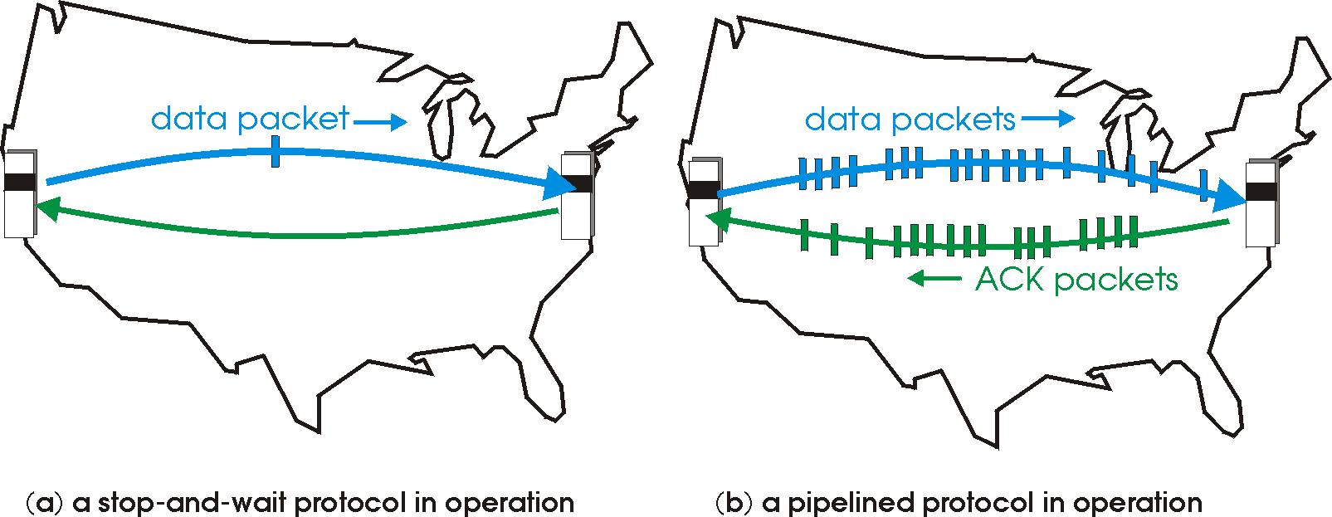

Pipelined/Sliding Window protocols
pipelining: sender allows multiple, “in-flight”, yet-to-be-acknowledged pkts
range of sequence numbers must be increased
buffering at sender and/or receiver
two generic forms of pipelined protocols: go-Back-N, selective repeat

Slide 10
Pipelining: increased utilization
sender
receiver
first packet bit transmitted, t = 0
last bit transmitted, t = L / R
first packet bit arrives
RTT
last packet bit arrives, send ACK
last bit of 2nd packet arrives, send ACK
last bit of 3rd packet arrives, send ACK
ACK arrives, send next
packet, t = RTT + L / R
3-packet pipelining increases
utilization by a factor of 3!

Slide 11
Pipelined protocols: overview
Go-back-N:
sender can have up to N unacked packets in pipeline
receiver only sends cumulative ack
doesn’t ack packet if there’s a gap
sender has timer for oldest unacked packet
when timer expires, retransmit all unacked packets
Selective Repeat:
sender can have up to N unack’ed packets in pipeline
rcvr sends individual ack for each packet
sender maintains timer for each unacked packet
when timer expires, retransmit only that unacked packet

Slide 12
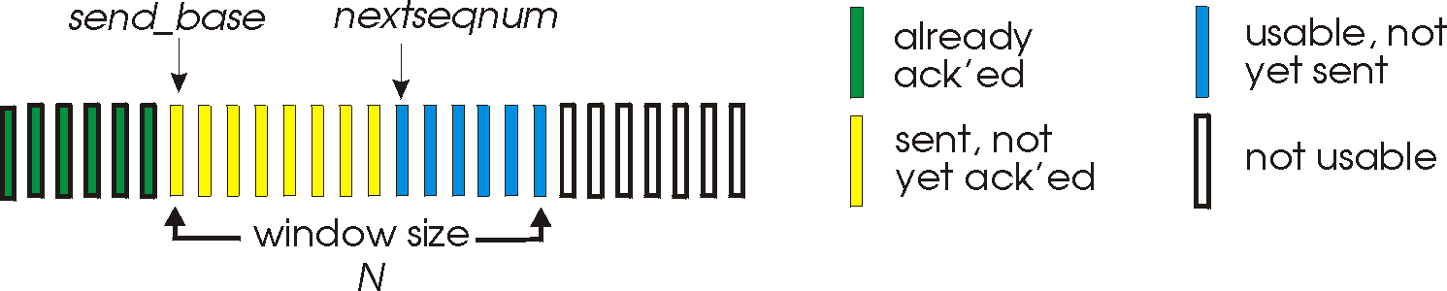
Go-Back-N: Sender
k-bit seq # in pkt header
“window” of up to N, consecutive unack’ed pkts allowed
ACK(n): ACKs all pkts up to, including seq # n - “cumulative ACK”
may receive duplicate ACKs (see receiver)
timer for oldest in-flight pkt
timeout(n): retransmit packet n and all higher seq # pkts in window

Slide 13
GBN: Receiver
ACK-only: always send ACK for correctly-received pkt with highest in-order seq #
may generate duplicate ACKs
need only remember expectedseqnum
out-of-order pkt:
discard (don’t buffer): no receiver buffering!
re-ACK pkt with highest in-order seq #

Slide 14
GBN in action
sender window (N=4)
sender
receiver
0 1 2 3 4 5 6 7 8
send pkt0
send pkt1
send pkt2
send pkt3
(wait)
0 1 2 3 4 5 6 7 8
receive pkt0, send ack0
receive pkt1, send ack1
receive pkt3, discard,
(re)send ack1
0 1 2 3 4 5 6 7 8
X
0 1 2 3 4 5 6 7 8
loss
0 1 2 3 4 5 6 7 8
rcv ack0, send pkt4
rcv ack1, send pkt5
0 1 2 3 4 5 6 7 8
receive pkt4, discard,
(re)send ack1
ignore duplicate ACK
receive pkt5, discard,
(re)send ack1
pkt 2 timeout
0 1 2 3 4 5 6 7 8
send pkt2
send pkt3
send pkt4
send pkt5
0 1 2 3 4 5 6 7 8
0 1 2 3 4 5 6 7 8
rcv pkt2, deliver, send ack2
rcv pkt3, deliver, send ack3
rcv pkt4, deliver, send ack4
rcv pkt5, deliver, send ack5
0 1 2 3 4 5 6 7 8

Slide 15
Selective repeat
receiver individually acknowledges all correctly received pkts
buffers pkts, as needed, for eventual in-order delivery to upper layer
sender only resends pkts for which ACK not received
sender timer for each unACKed pkt
sender window
N consecutive seq #’s
limits seq #s of sent, unACKed pkts

Slide 16
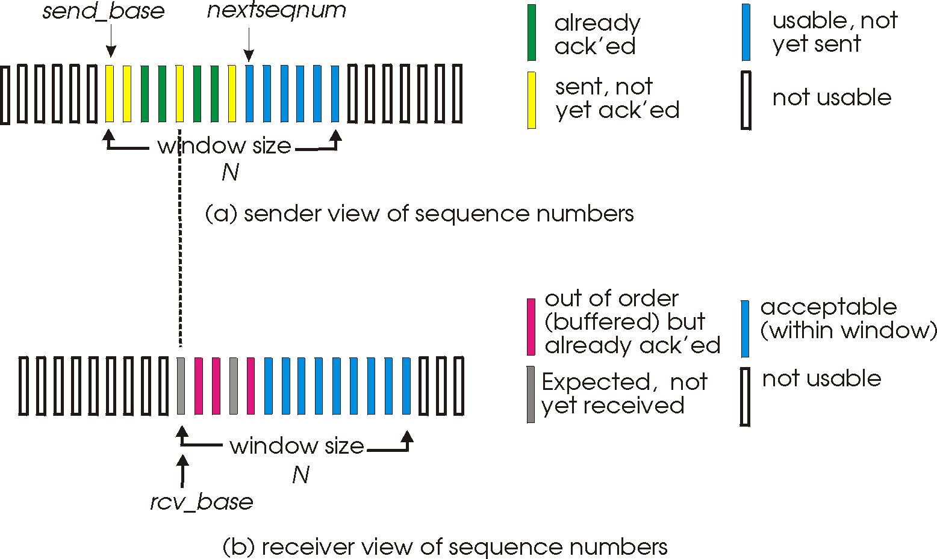
Selective repeat: sender, receiver windows

Slide 17
Selective repeat
sender
receiver
data from above:
if next available seq # in window, send pkt
timeout(n):
resend pkt n, restart timer
ACK(n) in [sendbase,sendbase+N]:
mark pkt n as received
if n smallest unACKed pkt, advance window base to next unACKed seq #
pkt n in [rcvbase, rcvbase+N-1]
send ACK(n)
out-of-order: buffer
in-order: deliver (also deliver buffered, in-order pkts), advance window to next not-yet-received pkt
pkt n in [rcvbase-N,rcvbase-1]
ACK(n)
otherwise:
ignore

Slide 18
Selective repeat in action
sender window (N=4)
sender
receiver
0 1 2 3 4 5 6 7 8
send pkt0
send pkt1
send pkt2
send pkt3
(wait)
0 1 2 3 4 5 6 7 8
receive pkt0, send ack0
receive pkt1, send ack1
receive pkt3, buffer,
send ack3
0 1 2 3 4 5 6 7 8
X
0 1 2 3 4 5 6 7 8
loss
0 1 2 3 4 5 6 7 8
rcv ack0, send pkt4
rcv ack1, send pkt5
0 1 2 3 4 5 6 7 8
receive pkt4, buffer,
send ack4
record ack3 arrived
receive pkt5, buffer,
send ack5
pkt 2 timeout
0 1 2 3 4 5 6 7 8
send pkt2
0 1 2 3 4 5 6 7 8
record ack4 arrived
0 1 2 3 4 5 6 7 8
rcv pkt2; deliver pkt2,
pkt3, pkt4, pkt5; send ack2
record ack5 arrived
0 1 2 3 4 5 6 7 8
Q: what happens when ack2 arrives?

Slide 19

Selective repeat: dilemma
sender window
(after receipt)
receiver window
(after receipt)
0 1 2 3 0 1 2
pkt0
0 1 2 3 0 1 2
pkt1
0 1 2 3 0 1 2
example:
seq #’s: 0, 1, 2, 3
window size=3
0 1 2 3 0 1 2
pkt2
0 1 2 3 0 1 2
0 1 2 3 0 1 2
0 1 2 3 0 1 2
pkt3
X
0 1 2 3 0 1 2
pkt0
will accept packet
with seq number 0
receiver sees no difference in two scenarios!
duplicate data accepted as new in (b)
Q: what relationship between seq # size and window size to avoid problem in (b)?
(a) no problem
receiver can’t see sender side.
receiver behavior identical in both cases!
something’s (very) wrong!
0 1 2 3 0 1 2
pkt0
0 1 2 3 0 1 2
pkt1
0 1 2 3 0 1 2
0 1 2 3 0 1 2
pkt2
0 1 2 3 0 1 2
X
0 1 2 3 0 1 2
X
timeout
retransmit pkt0
X
0 1 2 3 0 1 2
pkt0
will accept packet
with seq number 0
(b) oops!

Slide 20
Reliable Data Transfer Protocols Summary
 | Stop and Wait | GBN | Selective Repeat
(max/min) Sender’s buffer size | 1 | N | N
Receiver’s buffer size | 1 | 1 | N
(max/min) seq. no. | 2 | N+1 | N+N
No. of timers | 1 | 1 | N
Acknowledgement

Slide 21
Principles of congestion control
congestion:
informally: “too many sources sending too much data too fast for network to handle”
different from flow control!
manifestations:
lost packets (buffer overflow at routers)
long delays (queueing in router buffers)
a top-10 problem!

Slide 22

Causes/costs of congestion: scenario 1
original data: λ_{in}
throughput: λ_{out}
two senders, two receivers
one router, infinite buffers
output link capacity: R
no retransmission
Host A
unlimited shared output link buffers
Host B
R/2
λ_{out}
delay
λ_{in}
R/2
λ_{in}
R/2
maximum per-connection throughput: R/2
large delays as arrival rate, l_{in}, approaches capacity

Slide 23
Causes/costs of congestion: scenario 2
one router, finite buffers
sender retransmission of timed-out packet
application-layer input = application-layer output: l_{in} = l_{out}
transport-layer input includes retransmissions : l_{in} l_{in}
‘
λ_{in} : original data
λ'_{in}: original data, plus retransmitted data
λ_{out}
Host A
finite shared output link buffers
Host B

Slide 24
Causes/costs of congestion: scenario 2
R/2
idealization: perfect knowledge
sender sends only when router buffers available
λ_{out}
λ_{in}
R/2
λ_{in} : original data
copy
λ'_{in}: original data, plus retransmitted data
λ_{out}
A
free buffer space!
finite shared output link buffers
Host B

Slide 25

Causes/costs of congestion: scenario 2
Idealization: known loss packets can be lost, dropped at router due to full buffers
sender only resends if packet known to be lost
λ_{in} : original data
copy
λ'_{in}: original data, plus retransmitted data
λ_{out}
A
no buffer space!
Host B

Slide 26
Causes/costs of congestion: scenario 2
Idealization: known loss packets can be lost, dropped at router due to full buffers
sender only resends if packet known to be lost
R/2
when sending at R/2, some packets are retransmissions but asymptotic goodput is still R/2 (why?)
λ_{out}
λ_{in}
R/2
λ_{in} : original data
λ'_{in}: original data, plus retransmitted data
λ_{out}
A
free buffer space!
Host B

Slide 27


Causes/costs of congestion: scenario 2
Realistic: duplicates
packets can be lost, dropped at router due to full buffers
sender times out prematurely, sending two copies, both of which are delivered
R/2
when sending at R/2, some packets are retransmissions including duplicated that are delivered!
λ_{out}
λ_{in}
R/2
λ_{in}
copy
λ'_{in}
λ_{out}
timeout
A
free buffer space!
Host B

Slide 28
Causes/costs of congestion: scenario 2
Realistic: duplicates
packets can be lost, dropped at router due to full buffers
sender times out prematurely, sending two copies, both of which are delivered
R/2
when sending at R/2, some packets are retransmissions including duplicated that are delivered!
λ_{out}
λ_{in}
R/2
“costs” of congestion:
more work (retrans) for given “goodput”
unneeded retransmissions: link carries multiple copies of pkt
decreasing goodput

Slide 29
Causes/costs of congestion: scenario 3
Q: what happens as λ_{in} and λ_{in}’ increase ?
four senders
multihop paths
timeout/retransmit
A: as red λ_{in}’ increases, all arriving blue pkts at upper queue are dropped, blue throughput g 0
Host A
λ_{in} : original data
λ_{out}
Host B
λ'_{in}: original data, plus retransmitted data
finite shared output link buffers
Host D
Host C

Slide 30
Causes/costs of congestion: scenario 3
C/2
λ_{out}
λ_{in}’
C/2
another “cost” of congestion:
when packet dropped, any “upstream transmission capacity used for that packet was wasted!

Slide 31
Congestion Control and Resource Allocation
Resources
Bandwidth of the links
Buffers at the routers and switches
When too many packets are contending for the same link
The queue overflows
Packets get dropped
Network is congested!
Congestion control and Resource Allocation
Two sides of the same coin

Slide 32
Approaches towards congestion control
two broad approaches towards congestion control:
end-end congestion control:
no explicit feedback from network
congestion inferred from end-system observed loss, delay
approach taken by TCP
network-assisted congestion control:
routers provide feedback to end systems
single bit indicating congestion (SNA, DECbit, TCP/IP ECN, ATM)
explicit rate for sender to send at

Slide 33
Taxonomy in Resource Allocation/Congestion Control
Router-centric versus Host-centric
Reservation-based versus Feedback-based
Window-based versus Rate-based

Slide 34
Case study: ATM ABR congestion control
ABR: available bit rate:
“elastic service”
if sender’s path “underloaded”:
sender should use available bandwidth
if sender’s path congested:
sender throttled to minimum guaranteed rate
RM (resource management) cells:
sent by sender, interspersed with data cells
bits in RM cell set by switches (“network-assisted”)
NI bit: no increase in rate (mild congestion)
CI bit: congestion indication
RM cells returned to sender by receiver, with bits intact

Slide 35

Case study: ATM ABR congestion control
RM cell
data cell
two-byte ER (explicit rate) field in RM cell
congested switch may lower ER value in cell
senders’ send rate thus max supportable rate on path
EFCI bit in data cells: set to 1 in congested switch
if data cell preceding RM cell has EFCI set, receiver sets CI bit in returned RM cell

Slide 36
TCP Congestion Control
Source infers available network capacity
Self-clocking: using ACKs to pace (in-transit vs. left packets)
Host-centric, Feedback based, Window based mechanism
MaxWindow = MIN(CongestionWindow, AdvertisedWindow)
EffectiveWindow = MaxWindow − (LastByteSent − LastByteAcked).
Phases: SS and AIMD

Slide 37
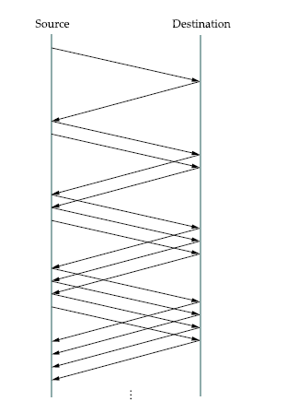
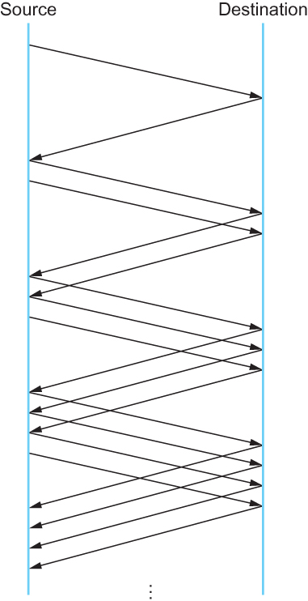
TCP Congestion Control: AIMD
Additive Increase Multiplicative Decrease
Packets in transit during additive increase, with one packet being added each RTT.

Slide 38
TCP Congestion Control: AIMD
approach: sender increases transmission rate (window size), probing for usable bandwidth, until loss occurs
additive increase: increase cwnd by 1 MSS every RTT until loss detected
multiplicative decrease: cut cwnd in half after loss
additively increase window size …
…. until loss occurs (then cut window in half)
AIMD saw tooth
behavior: probing
for bandwidth
cwnd: TCP sender
congestion window size
time

Slide 39
TCP Congestion Control: details
sender sequence number space
TCP sending rate:
roughly: send cwnd bytes, wait RTT for ACKS, then send more bytes
cwnd
last byte
ACKed
last byte sent
sent, not-yet ACKed
(“in-flight”)
sender limits transmission:
cwnd is dynamic, function of perceived network congestion
LastByteSent-
LastByteAcked
cwnd
<
cwnd
rate
~
bytes/sec
~
RTT

Slide 40
TCP Slow Start
Host A
Host B
when connection begins, increase rate exponentially until first loss event:
initially cwnd = 1 MSS
double cwnd every RTT
done by incrementing cwnd for every ACK received
summary: initial rate is slow but ramps up exponentially fast
one segment
RTT
two segments
four segments
time

Slide 41
TCP: Detecting, Reacting To Loss
Loss indicated by timeout:
cwnd set to 1 MSS;
window then grows exponentially (as in slow start) to threshold, then grows linearly
loss indicated by 3 duplicate ACKs: TCP RENO
dup ACKs indicate network capable of delivering some segments
cwnd is cut in half window then grows linearly
Fast Recovery
TCP Tahoe always sets cwnd to 1 : both for timeout or 3 duplicate ACKs

Slide 42
Cf. TCP Fast Retransmit
time-out period often relatively long:
long delay before resending lost packet
detect lost segments via duplicate ACKs.
sender often sends many segments back-to-back
if segment is lost, there will likely be many duplicate ACKs.
TCP fast retransmit
if sender receives 3 ACKs for same data
(“triple duplicate ACKs”), resend unacked segment with smallest seq #
likely that unacked segment lost, so don’t wait for timeout
(“triple duplicate ACKs”),

Slide 43
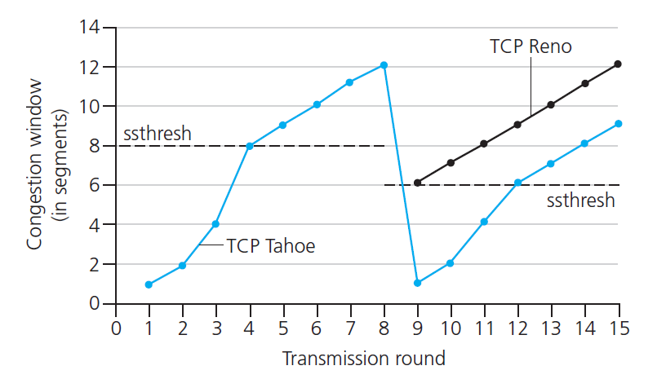
TCP: switching from slow start to CA
Q: when should the exponential increase switch to linear?
A: when cwnd gets to 1/2 of its value before timeout.
Implementation:
variable ssthresh
on loss event, ssthresh is set to 1/2 of cwnd just before loss event

Slide 44
TCP sender congestion control
State | Event | TCP Sender Action | Commentary
Slow Start (SS) | ACK receipt for previously unacked data | CongWin = CongWin + MSS, If (CongWin > Threshold) set state to “Congestion Avoidance” | Resulting in a doubling of CongWin every RTT
Congestion Avoidance (CA) | ACK receipt for previously unacked data | CongWin = CongWin+MSS * (MSS/CongWin) | Additive increase, resulting in increase of CongWin by 1 MSS every RTT
SS or CA | Loss event detected by triple duplicate ACK | Threshold = CongWin/2, CongWin = Threshold, Set state to “Congestion Avoidance” | Fast recovery, implementing multiplicative decrease. CongWin will not drop below 1 MSS.
SS or CA | Timeout | Threshold = CongWin/2, CongWin = 1 MSS, Set state to “Slow Start” | Enter slow start
SS or CA | Duplicate ACK | Increment duplicate ACK count for segment being acked | CongWin and Threshold not changed

Slide 45
TCP Throughput
avg. TCP thruput as function of window size, RTT?
ignore slow start, assume always data to send
W: window size (measured in bytes) where loss occurs
avg. window size (# in-flight bytes) is ¾ W
avg. thruput is 3/4W per RTT
avg TCP thruput =
3
W
4
RTT
bytes/sec
W
W/2

Slide 46
TCP Futures: TCP over “long, fat pipes”
example: 1500 byte segments, 100ms RTT, want 10 Gbps throughput
requires W = 83,333 in-flight segments
throughput in terms of segment loss probability, L [Mathis 1997]:
➜ to achieve 10 Gbps throughput, need a loss rate of L = 2·10⁻¹⁰ – a very small loss rate!
new versions of TCP for high-speed
1.22
.
MSS
TCP throughput =
RTT
L

Slide 47
TCP Fairness
fairness goal: if K TCP sessions share same bottleneck link of bandwidth R, each should have average rate of R/K
TCP connection 1
bottleneck
router
capacity R
TCP connection 2

Slide 48
Why is TCP fair?
two competing sessions:
additive increase gives slope of 1, as throughout increases
multiplicative decrease decreases throughput proportionally
R
equal bandwidth share
Connection 2 throughput
loss: decrease window by factor of 2
congestion avoidance: additive increase
loss: decrease window by factor of 2
congestion avoidance: additive increase
Connection 1 throughput
R

